Slide 1
Predicting Bike-Sharing Demand
Classification, count regression and time-series forecasting on Capital Bikeshare data (Washington D.C., 2011–2012)
Predictive Analytics (CSE3141) | Project 2026
Atreya Mitra | Manipal University Jaipur
Notes:
Introduce the project: one real dataset used to cover the whole predictive analytics syllabus.

Slide 2
The problem: how many bikes, and when?
Operators must rebalance bikes before the rush, not after it
Goal: predict demand from weather, calendar and time of day
Four questions: classify busy hours, explain counts, forecast daily demand, validate honestly
Data: UCI Bike Sharing Dataset, 2 years of real rentals
17,379
hourly records
731
daily records (2011–2012)
+64.4%
growth in daily rentals, 2012 vs 2011
2
Notes:
Operators must place bikes before demand appears, so we need predictions. Dataset: UCI Bike Sharing, hourly and daily files.

Slide 3
One dataset, the whole syllabus
1
2
3
4
5
Prepare & explore
Classify
Model counts
Forecast
Validate & tune
cleaning, outliers, EDA, features
logistic, LDA, QDA, multinomial
Gaussian, Poisson, Neg. Binomial GLM
ARIMA, SARIMA, smoothing, SARIMAX
CV, RMSE, MAE, F1, AUC, grid/random search
Ethics threaded through: privacy, fairness feedback loops, leakage, honest evaluation
3
Notes:
Walk through the pipeline and map each stage to the syllabus unit.

Slide 4
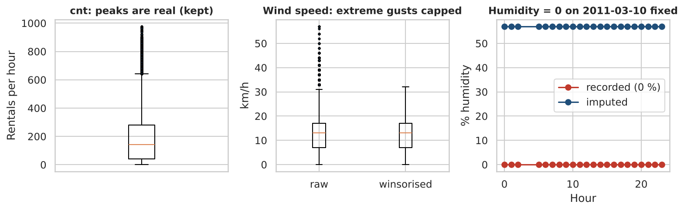
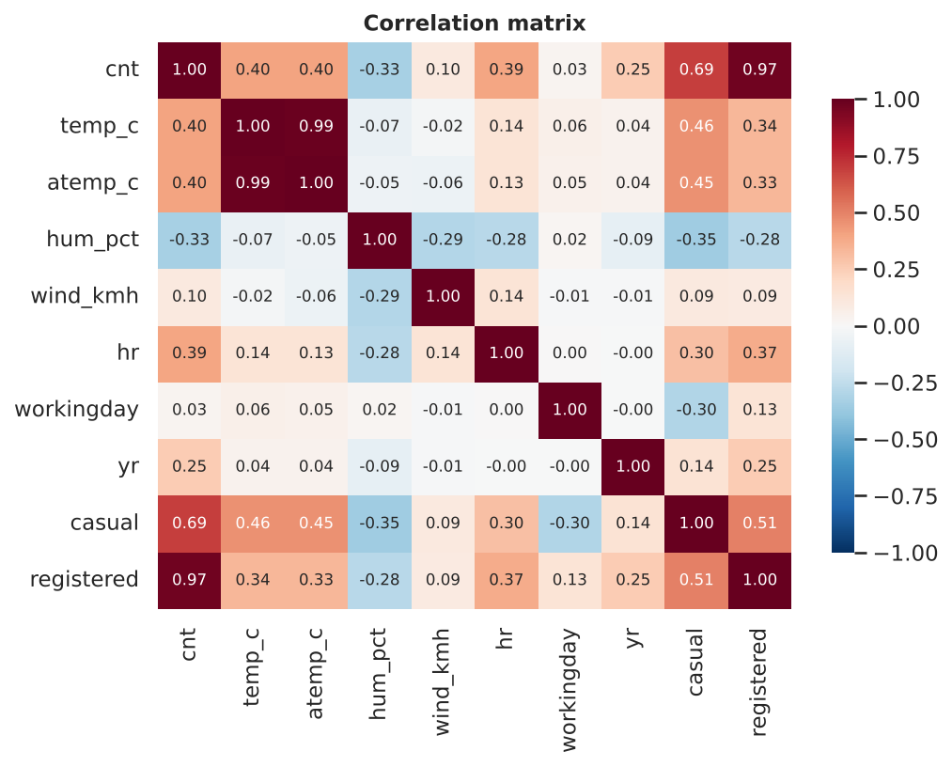
Data preparation: real-world problems found
No missing cells, but 165 hours are absent (no rentals)
Humidity = 0 % in 22 rows on one day: impossible, imputed with month median
Outliers (IQR rule): demand peaks kept (real), extreme wind gusts capped
Leakage: cnt = casual + registered, so both excluded as predictors
Collinearity: temp vs feels-like VIF 44 → 1.0 after dropping one
Features: cyclic hour (sin/cos), day-type interactions, weather dummies
4
Notes:
Humidity zero on 10 March 2011 was imputed. Demand peaks are real so kept. Casual + registered = cnt so they are leakage.

Slide 5
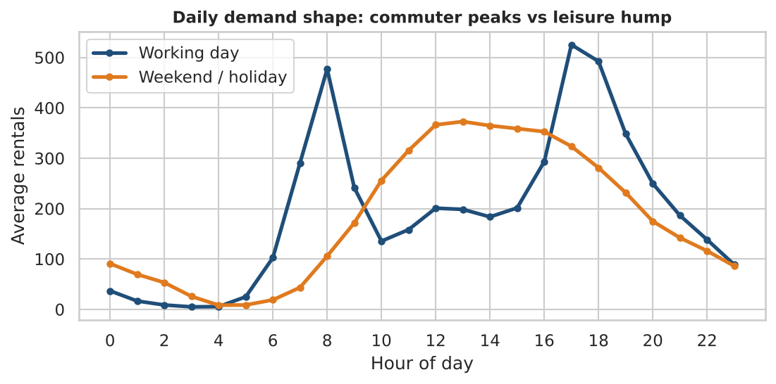
Demand has two shapes: commute and leisure
Working days: peaks at 08:00 and 17:00–18:00 (≈525 rentals/h at 17:00)
Weekends: single hump at 13:00 (≈373)
Counts are right-skewed and overdispersed (variance ≫ mean)
So the hour effect must depend on day type
5
Notes:
Working days have 08:00 and 17-18:00 peaks; weekends peak at midday. Overdispersion visible on the right of the first chart.

Slide 6
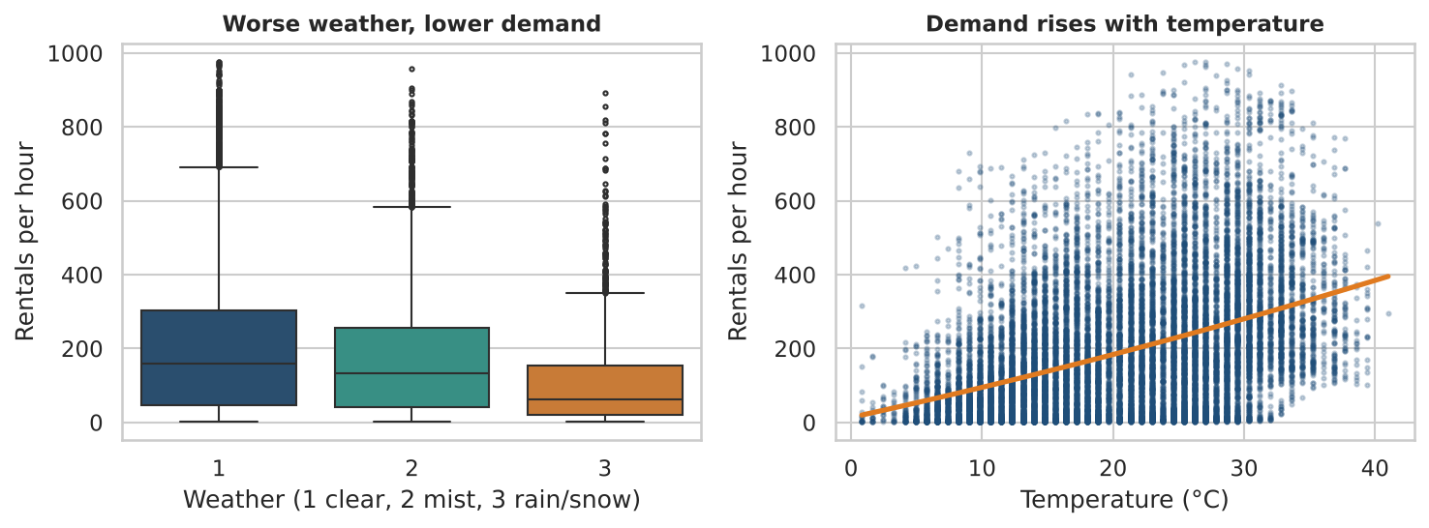
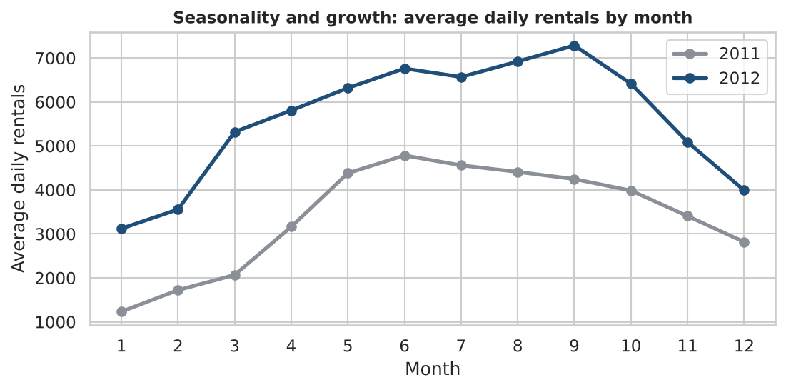
Season, growth and weather all matter
Winter low, summer/early-autumn high; 2012 above 2011 every month
Mean hourly rentals: clear 205, mist 175, rain/snow 112
Temperature is the strongest weather driver (r = 0.41)
6
Notes:
Demand grew 64 percent from 2011 to 2012; rain and snow halve demand.

Slide 7
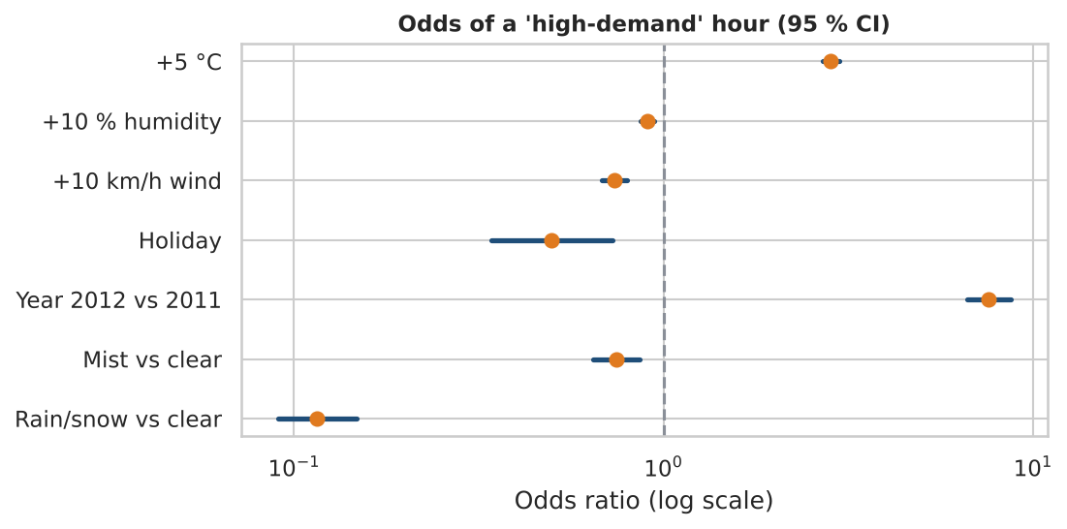
Logistic regression: what makes an hour busy?
+5 °C → odds ×2.84
Rain/snow → odds ×0.12 (−88 %)
+10 km/h wind → ×0.74
Holiday → ×0.50
LR test p < 0.001; McFadden R² = 0.6341
Test AUC 0.954, F1 0.882
7
Notes:
Odds ratios with 95 percent CIs. LR test chi-square 12,221 on 16 df, McFadden R2 0.634.

Slide 8
LDA, QDA and multinomial logit
Model | Accuracy | F1 | AUC
Logistic regression | 0.880 | 0.882 | 0.954
LDA | 0.877 | 0.882 | 0.952
QDA | 0.854 | 0.862 | 0.935
Odds of high vs low demand (multinomial)
+1 °C: ×1.44
Rain/snow: ×0.017
Holiday: ×0.30
Medium-level odds for rain/snow: ×0.108
LDA ≈ logistic: both give a linear boundary
QDA is weaker: dummy and harmonic features are far from Gaussian
Multinomial logit (low / medium / high): accuracy 79.9 %, macro-F1 0.801
Only 5 low hours predicted high; errors are mostly neighbouring levels
8
Notes:
LDA matches logistic (both linear). QDA overfits covariance structure. Multinomial gets 80 percent on three levels, mistakes are adjacent levels.

Slide 9
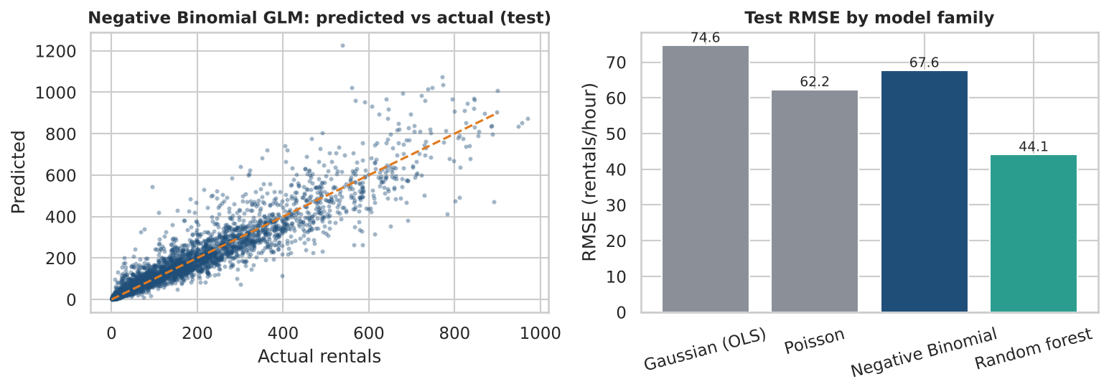
Count models: why Negative Binomial?
Poisson assumes variance = mean; here dispersion is 14.28
Poisson standard errors are ~3.52× too small
NB rate ratios: +1 °C ≈ +3.6 %, rain/snow ≈ −41 %, holiday ≈ −10 %, 2012 ≈ +60 %
NB for explanation, random forest for prediction
Model | Dispersion | Test RMSE | Test MAE
Gaussian GLM (OLS) | 6144.34 | 74.6 | 51.4
Poisson GLM | 14.28 | 62.2 | 38.7
Negative Binomial GLM | 1.84 | 67.6 | 40.5
Random forest regressor | – | 44.1 | 26.3
9
Notes:
Poisson dispersion 14; NB reduces to 1.8 and has by far the lowest AIC. Random forest predicts best but cannot explain.

Slide 10
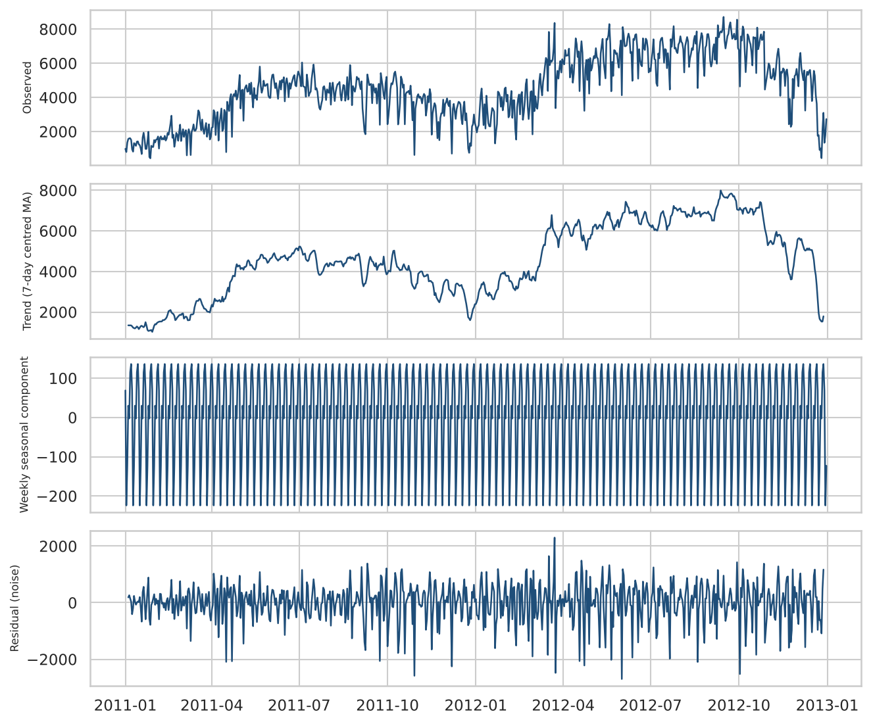
Time series: trend dominates, weekly pattern is weak
Trend ≈ 86 % of variance; weekly season ≈ 0.4 %
ADF on level: p = 0.4459 (non-stationary); after d = 1: p < 0.001
7 extreme days flagged (e.g. Hurricane Sandy, 22 rentals): interpolated in training data only
Hold-out: last 60 days (2012-11-02 to 2012-12-31)
Models: ARIMA, SARIMA(…)₇, Holt–Winters, SARIMAX
10
Notes:
ADF test: level not stationary (p 0.45); differenced stationary. Hurricane Sandy day flagged and interpolated in training data only.

Slide 11
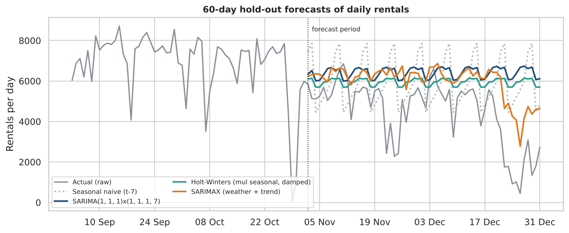
Forecasting 60 days: weather-aware model wins
Model | RMSE | MAE
Naive | 2,168 | 1,565
SARIMA | 2,491 | 1,958
Holt-Winters | 2,140 | 1,555
SARIMAX (weather) | 1,795 | 1,492
SARIMAX: 16 % lower RMSE than the best univariate model
ARIMA/SARIMA are worse than the naive forecast over this horizon
Rolling-origin (4 × 30 days): SARIMAX 1293 vs Holt–Winters 1625 vs naive 1797
Regressors: temperature, humidity, wind, holiday, bad weather, holiday week, trend
11
Notes:
Univariate ARIMA/SARIMA cannot anticipate the winter drop with only two years of data. SARIMAX uses observed weather so it is an upper bound.

Slide 12
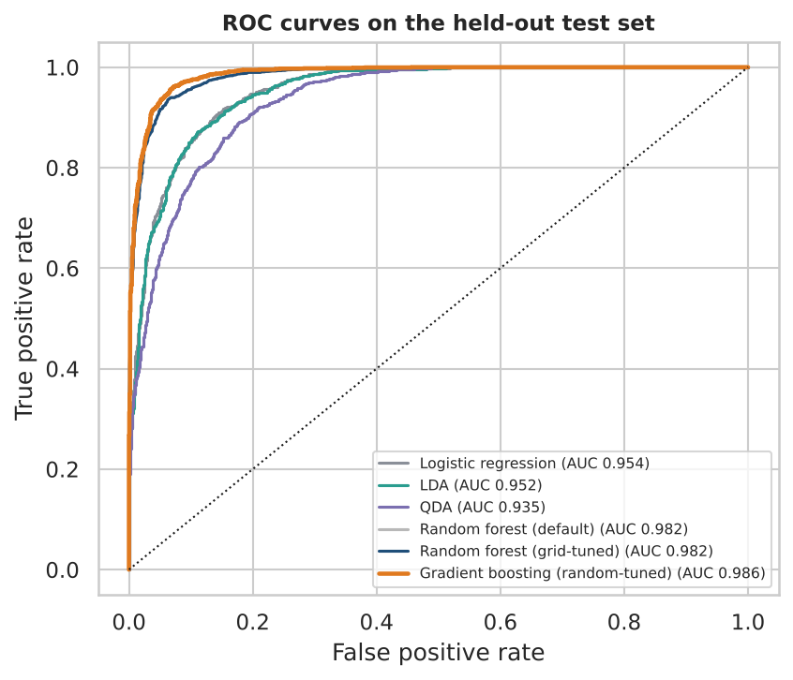
Validation: tree ensembles lead on unseen data
Model | CV F1 | Prec. | Recall | F1 | AUC
Logistic regression | 0.893 | 0.869 | 0.894 | 0.882 | 0.954
LDA | 0.890 | 0.844 | 0.924 | 0.882 | 0.952
QDA | 0.866 | 0.817 | 0.913 | 0.862 | 0.935
Random forest (default) | 0.929 | 0.920 | 0.944 | 0.932 | 0.982
Random forest (grid-tuned) | 0.929 | 0.920 | 0.944 | 0.932 | 0.982
Gradient boosting (random-tuned) | 0.943 | 0.930 | 0.961 | 0.945 | 0.986
Random 5-fold CV F1 = 0.933 vs time-ordered CV = 0.852: random folds are optimistic for time data
Chronological hold-out (train to 2012-07-02): F1 0.933, AUC 0.979
12
Notes:
Test set of 3,476 hours. Gradient boosting tuned by random search is best. Time-ordered CV gives lower F1 than random CV.

Slide 13
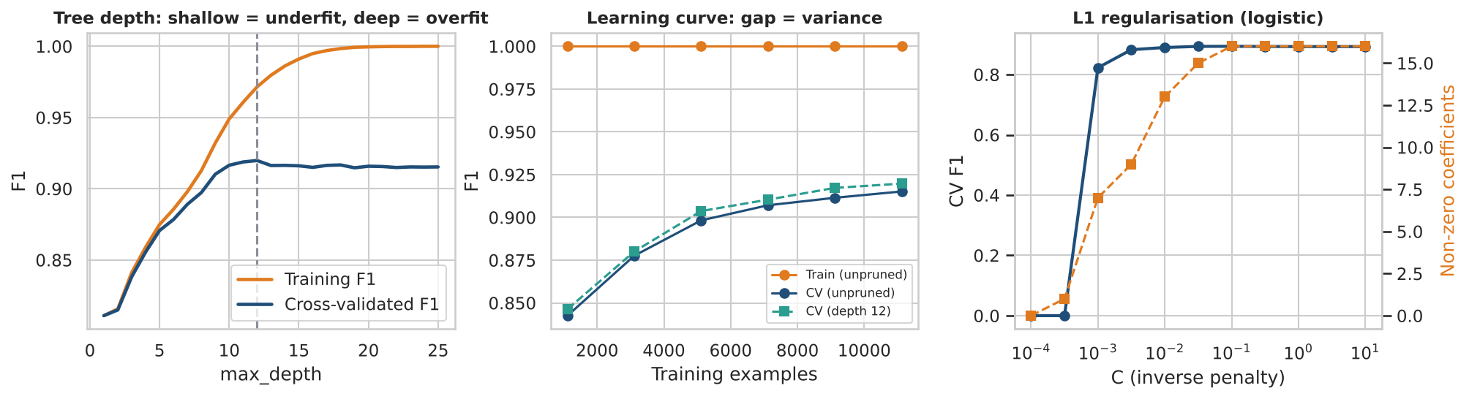
Tuning, over- and under-fitting
Grid search: 24 forest settings × 5 folds, CV F1 0.929 = default (tuning did not help)
Random search: 25 boosting settings, CV F1 0.943 → test F1 0.945
Depth 1 underfits; depth > 12 memorises training data (train F1 → 1.0, CV flat)
Controls: pruning, bagging, boosting shrinkage + L2, L1 penalty, cross-validated selection
13
Notes:
Grid search for the forest found the default was already optimal; random search improved boosting by about 1.4 points. Tree depth shows the bias-variance trade-off.

Slide 14
What the operator should do
Actions
Limitations and ethics
Rebalance before the 08:00 and 17:00–18:00 peaks
Plan fleet and maintenance around rain/snow forecasts (≈ −41 % rentals)
Reduce operations in holiday week and deep winter
Send dispatchers a daily high-demand probability
Only 2 years: no annual seasonality; winter hold-out is hard
SARIMAX uses observed weather (upper bound)
City-wide totals: no station-level fairness view
Models learn where demand already is: risk of reinforcing gaps
Keep data aggregated, no rider identifiers
14
Notes:
Recommendations are directly supported by the odds ratios and rate ratios; limitations are stated honestly.

Slide 15
Conclusion
Preparation mattered as much as the algorithm (humidity fault, outliers, leakage, collinearity)
Logistic and NB models explain demand; boosting predicts it best (AUC 0.986)
Counts are overdispersed: Negative Binomial is the valid inference model
Weather-aware SARIMAX beats univariate forecasts over 60 days
Honest validation: time-ordered CV, held-out test, report when tuning does not help
Thank you | Questions?
Notes:
Close with the key messages and invite questions.

